Slide 1
Introduction to data science
Copyright McGraw Hill, Rosen, Discrete Mathematics and its Applications

Slide 2
Early data science
During WWII, statistician Abraham Wald was asked to help the British decide where to add armor to their planes
This image depicts the bullets holes observed on planes that returned from the front

Slide 3

Example: Automating science
Sky image cataloging (Fayyad et al 1993)
3 TB of image data from Palomar Observatory Sky Study
Task: Automatically categorize 100 million stellar objects (e.g., star/galaxy)
94% accuracy using 1700 examples and 40 features
Also identified objects too faint for humans to assess

Slide 4
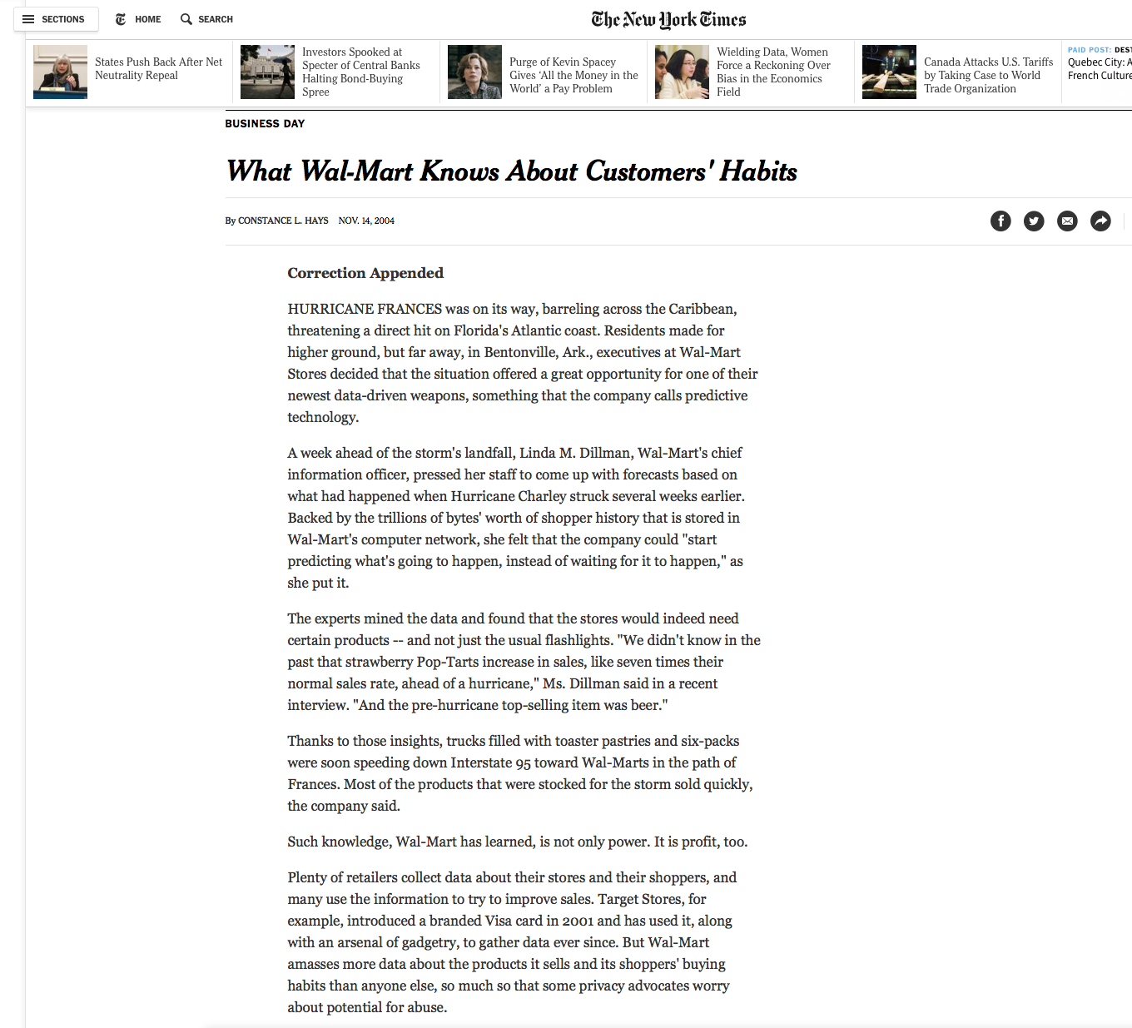
Example: Supply chain

Slide 5
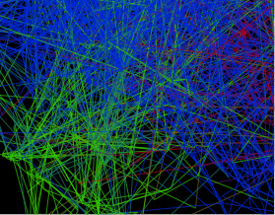
Example: Fraud detection
Broker malfeasance (Neville et al 2005)
600,000+ stock brokers are registered trade on the NASDAQ
FINRA investigates 6,000 brokers per year to identify and limit fraud/malfeasance
Task: Automatically predict brokers likely to be fraudulent, using organizational network information
ML methods identified new cases that previous hand-crafted rules wouldn’t have caught

Slide 6
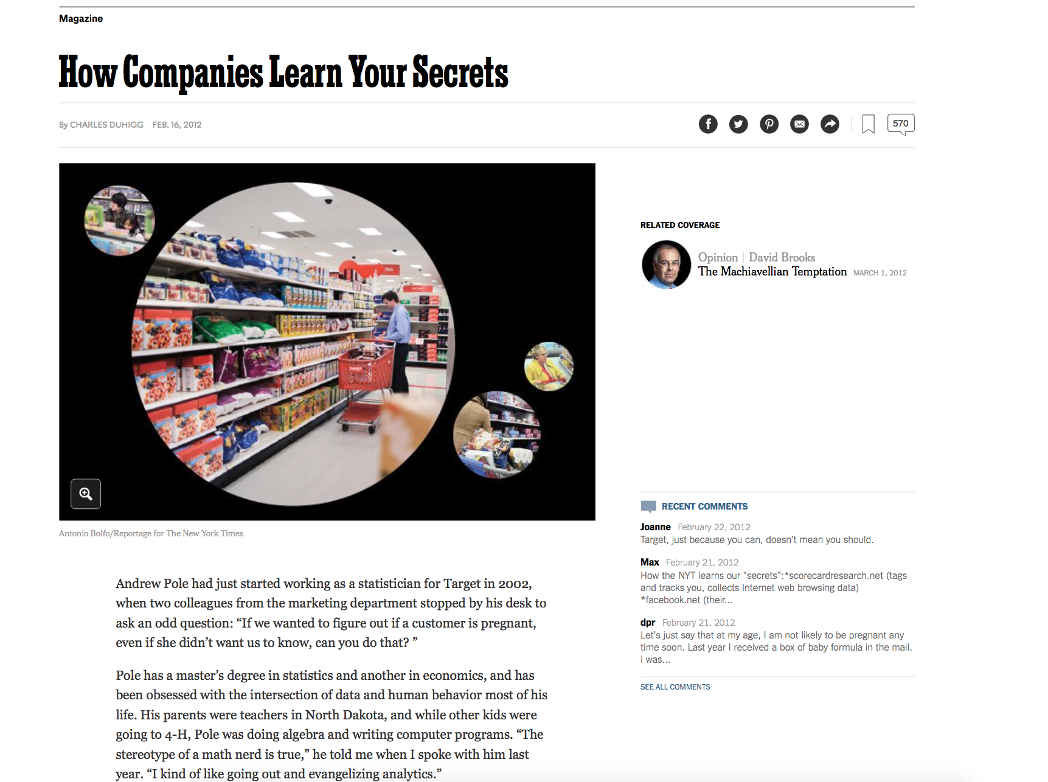
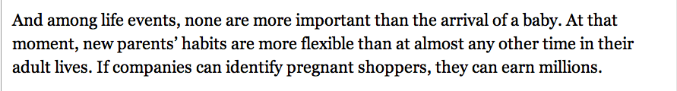
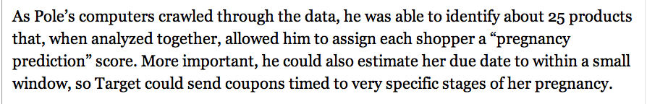
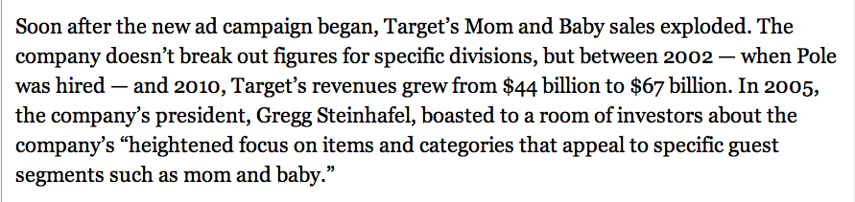
Example: Targeted marketing

Slide 7
Example: Healthcare
Early detection of sepsis (Henry et al. 2015)
Electronic health records of 16,234 patients
Cox proportional hazards model. Uses 27 factors, based on routinely collected inputs
ML method correctly predicts septic shock in 85% cases, without increasing false positives
More than 2/3 of the time, ML method correctly predicted septic shock before any organ dysfunction — a 60% improvement over existing screening protocols

Slide 8

What is data science?
Definition of data mining
The process of identifying valid, novel, potentially useful, and ultimately understandable patterns in data (Fayyad, Piatetsky-Shapiro & Smith 1996)
Artificial Intelligence
Databases
Visualization
Statistics

Slide 9
Data science

Slide 10
Modern Data Scientist

Slide 11
Big Data Analytics Pipeline and Stakeholders

Slide 12










Data science process
Selection
Target data
Preprocessing
Processed data
Data
Interpretation evaluation
Mining
Knowledge
Patterns

Slide 13
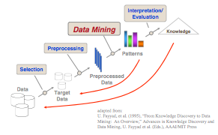
Data science process
FINRA fraud detection example
Evaluate qualitatively on historical data and subjective assessment by expert analysts
Learn graphical models, output predictions and model structure
Create target class label, temporal features
Extract data about small firms in a few geographic locations
Use public data from FINRA BrokerCheck

